Slide 1


JAVA basics
Notes:
*

Slide 2
Java variables
Variable is a name of memory location. There are three types of variables in java: local, instance and static.
There are two types of data types in java: primitive and non-primitive.
Variable is name of reserved area allocated in memory. In other words, it is a name of memory location.

Slide 3

INDEX
Variables
Methods
Access Modifiers
Method Overloading
Non Access Modifiers
Final
Static
Constructors
Arrays
Notes:
*

Slide 4
Types of Variable
There are three types of variables in java:
local variable
instance variable
static variable

Slide 5
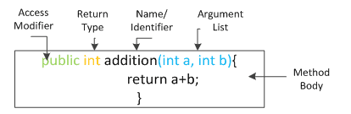
methods
A method is a program module that contains a series of statements that carry out a task.
To execute a method, you invoke or call it from another method.
Notes:
*

Slide 6
Access modifiers
Each object has members (members can be variable and methods) which can be declared to have specific access.
In Java, modifiers are categorized into two types,
Access control modifier
Non Access Modifier
Notes:
*

Slide 7
Access control modifier
Java language has four access modifier to control access levels for classes, variable methods and constructor.
Default : Default has scope only inside the same package
Public : Public has scope that is visible everywhere
Protected : Protected has scope within the package and all sub classes
Private : Private has scope only within the classes
Notes:
*

Slide 8
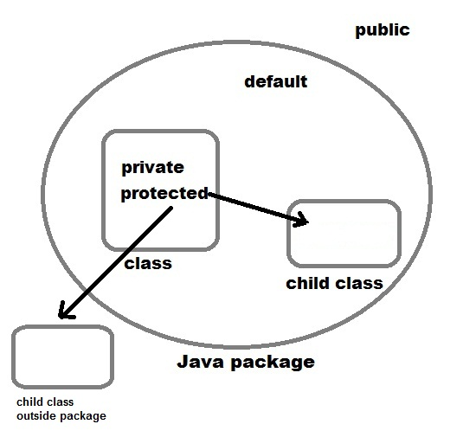
Access control modifier
Notes:
*

Slide 9
Access control modifier
Modifier | Class | Constructor | Method | Data/variables
Public | Yes | Yes | Yes | Yes
Protected |  | Yes | Yes | Yes
Default | Yes | Yes | Yes | Yes
Private |  | Yes | Yes | Yes
Notes:
*

Slide 10
Questions
Can we overload the main() method?
Yes, we can overload a main() method. A class can have any number of main() methods. But, one of those must be in the form “public static void main(String[] args)” in order to start the execution.
What is an Instance variable?
Instance variables are variables within a class but outside any method. These variables are instantiated when the class is loaded.
What is Java Virtual Machine and how it is considered in context of Java’s platform independent feature?
When Java is compiled, it is not compiled into platform specific machine, rather into platform independent byte code. This byte code is distributed over the web and interpreted by virtual Machine (JVM) on whichever platform it is being run.
Can we have protected class?
No, we cannot have class or interface with protected modifier. Only fields, methods and constructors can be protected.
Notes:
*

Slide 11
Method overloading
If two or more method in a class have same name but different parameters, it is known as method overloading.
Overloading always occur in the same class(unlike method overriding).
Method overloading is one of the ways through which java supports polymorphism.
Method overloading can be done by changing number of arguments or by changing the data type of arguments.
Notes:
*

Slide 12
What is method signature
A method signature is the method name and the number and type of its parameters.
Return types and thrown exceptions are not considered to be a part of the method signature.
Notes:
*

Slide 13
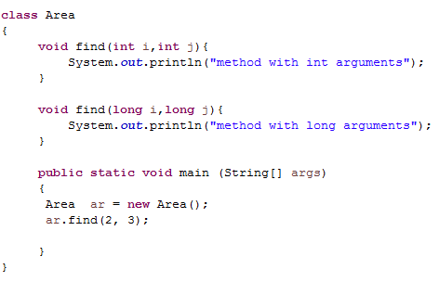
Question - 1
Output:
Notes:
*

Slide 14
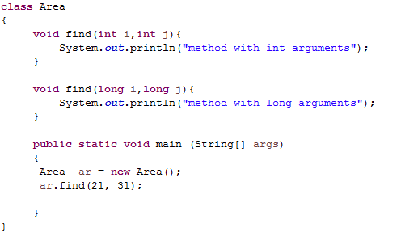
Question - 2
Output:
Notes:
*

Slide 15
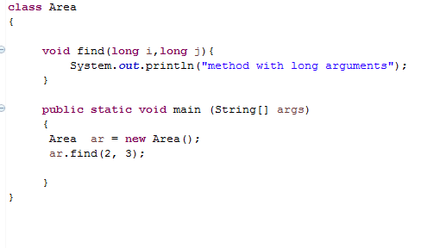
Question - 3
Output:
Notes:
*

Slide 16
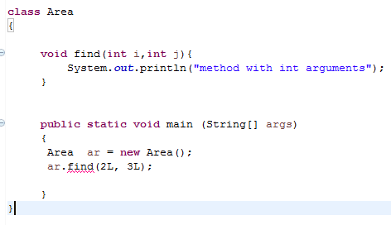
Question - 4
Output:
Notes:
*

Slide 17
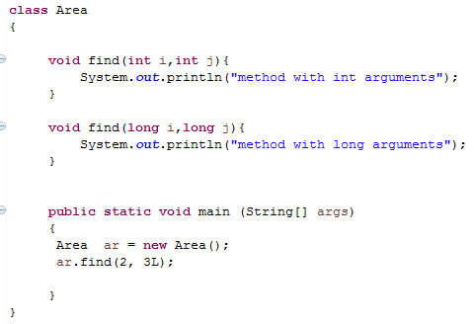
Question - 5
Output:
Notes:
*

Slide 18
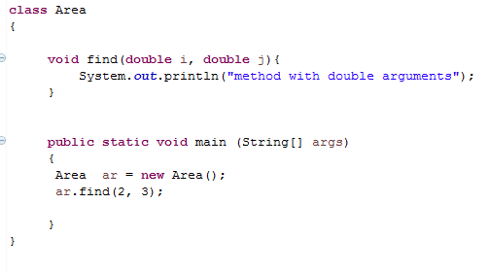
Question - 6
Output:
Notes:
*

Slide 19
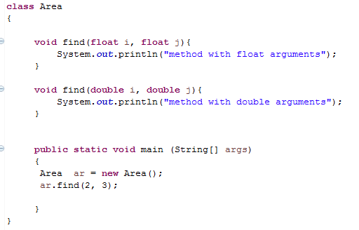
Question - 7
Output:
Notes:
*

Slide 20
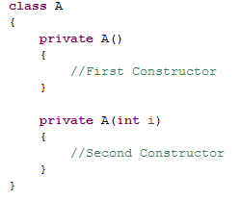
Questions
Q – 8. Can we overload static methods in java?
Q – 9. Can we use a field or a method declared without access modifiers outside the package.?
Q – 10. Can you create a sub class to the following class?
Notes:
*

Slide 21
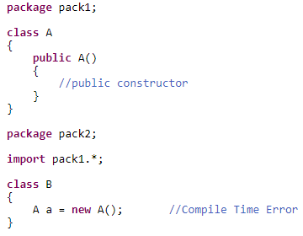
Questions
Q – 11. Why we can’t instantiate Class-A in the below code outside the package even though it has public constructor?
Notes:
*

Slide 22
Questions
Q – 12. Can we declare static methods as private?
Q – 13. What is the use of final keyword in java?
Q – 14. Is it possible to declare final variables without initialization?
Q – 15. Where all we can initialize a final non-static global variable if it is not initialized at the time of declaration?
Q – 16. Where all we can initialize a final static global variable if it is not initialized at the time of declaration?
Q – 17. Can we declare constructors as final?
Q – 18. Can we create object for final class?
Notes:
*

Slide 23
answers
Q – 1 method with int argument
Q – 2 method with long argument.
Q – 3 method with long argument.
Q – 4 Error
Q – 5 method with long argument.
Q – 6 method with double argument.
Q – 7 method with float argument.
Q – 8 The answer is ‘Yes’. We can have two ore more static methods with same name, but differences in input parameters.
Q – 9 A variable or method declared without any access control modifier is available to any other class in the same package.
Q – 10 No because constructors are private
Q – 11 because class is not visible outside the package
Notes:
*

Slide 24
answers
Q – 12 Yes
Notes:
*

Slide 25
Non access modifier
Non-access modifiers do not change the accessibility of variables and methods, but they do provide them special properties. Non-access modifiers are of 5 types,
Final
Static
Transient
Synchronized
Volatile
Notes:
*

Slide 26
final
This modifier applicable to class, method, and variables.
This modifier tells the compiler not to change the value of a variable once assigned.
If applied to class, it cannot be sub-classed. If applied to a method, the method cannot be overridden in sub-class.
A final method can be inherited/used in the subclass, but it cannot be overriden.
final int a = 5;
class StudyJava{
final void learn(){System.out.println("learning something new");
}
}
Notes:
*

Slide 27
final
A reference variable declared final can never be reassigned to refer to an different object.
However, the data within the object can be changed. So, the state of the object can be changed but not the reference.
Notes:
*

Slide 28
static
Static modifier is applicable to:
Method
Variable
Class nested within another class
Initialization block
Static modifier is not applicable to:
Class (Not Nested)
Constructor
Interfaces
Method Local Inner Class
Inner Class methods
Instance Variables
Local Variables
Notes:
*

Slide 29
static
Static Modifiers are used to create class variable and class methods which can be accessed without instance of a class.
Static variables are defined as a class member that can be accessed without any object of that class.
Static variable has only one single storage.
All the object of the class having static variable will have the same instance of static variable.
Static variables are initialized only once.
Notes:
*

Slide 30
Static variable vs Instance Variable
Static variable | Instance Variable
Represent common property | Represent unique property
Accessed using class name | Accessed using object
get memory only once | get new memory each time a new object is created
Notes:
*

Slide 31
Static method
A method can also be declared as static.
Static methods do not need instance of its class for being accessed.
main() method is the most common example of static method.
main() method is declared as static because it is called before any object of the class is created.
Notes:
*

Slide 32
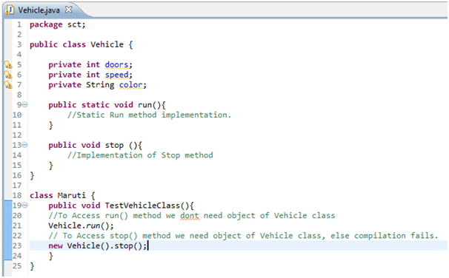
Static method
Notes:
*

Slide 33
Static block
Java supports a special block, called static block (also called static clause) which can be used for static initializations of a class.
This code inside static block is executed only once: the first time you make an object of that class or the first time you access a static member of that class (even if you never make an object of that class).
Also, static blocks are executed before constructors.
Notes:
*

Slide 34
What is the use of static block
Static block is mostly used for changing the default values of static variables. This block gets executed when the class is loaded in the memory.
A class can have multiple Static blocks, which will execute in the same sequence in which they have been written into the program.
Notes:
*

Slide 35
Non access modifiers
Transient modifier
When an instance variable is declared as transient, then its value doesn't persist when an object is serialized
Synchronized modifier
When a method is synchronized it can be accessed by only one thread at a time.
Volatile modifier
The volatile modifier is used to let the JVM know that a thread accessing the variable must always merge its own private copy of the variable with the master copy in the memory.
Accessing a volatile variable synchronizes all the cached copied of the variables in the main memory. Volatile can only be applied to instance variables, which are of type object or private.
Notes:
*

Slide 36
Constructors
A constructor is a special method that is used to initialize an object.
It is treated as a special member function because its name is the same as the class name.
Java constructors are invoked when their objects are created
Every class has a constructor.
If we don't explicitly declare a constructor for any java class the compiler builds a default constructor for that class.
A constructor does not have any return type.
Constructor in Java can not be abstract, static, final or synchronized. These modifiers are not allowed for constructor.
Notes:
*

Slide 37
Types of constructors
Default constructor (no-arg constructor) - A constructor having no parameter is known as default constructor. It is also known as no-arg constructor.
Parameterized constructor - A constructor having argument list is known as parameterized constructor.
Notes:
*

Slide 38
Constructor overloading
Like methods, a constructor can also be overloaded.
Overloaded constructors are differentiated on the basis of their type of parameters or number of parameters.
class paramC{
paramC(int a, int b){
System.out.print("Parameterized Constructor");
System.out.println(" having Two parameters");
}
paramC(int a, int b, int c){
System.out.print("Parameterized Constructor");
System.out.println(" having Three parameters");
}
}
Notes:
*

Slide 39
This keyword
this keyword is used to refer to current object.
this is always a reference to the object on which method was invoked.
this can be used to invoke current class constructor.
this can be passed as an argument to another method.
class Box
{
Double width, height, depth;
Box (double w, double h, double d)
{
this.width = w;
this.height = h;
this.depth = d;
}
}
Notes:
*

Slide 40
call overloaded constructor
public class ThisExample {
ThisExample() {
this("Java");
System.out.println("Inside Constructor without parameter");
}
ThisExample(String str) {
System.out
.println("Inside Constructor with String parameter as " + str);
}
}
this keyword can only be the first statement in Constructor.
A constructor can have either this or super keyword but not both.
Notes:
*

Slide 41
Call method of the class
public void getName()
{
System.out.println("StudyJava");
}
public void display()
{
this.getName();
System.out.println();
}
Notes:
*

Slide 42
This as method parameter
void method() {
method1(this);
}
void method1(JBT1 t) {
System.out.println(t.i);
}
Notes:
*

Slide 43
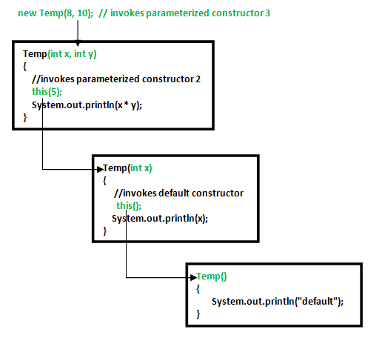
Constructor chaining
Notes:
*

Slide 44
arrays
An array is a collection of similar data types.
Array is a container object that hold values of homogenous type.
It is also known as static data structure because size of an array must be specified at the time of its declaration.
An array can be either primitive or reference type. It gets memory in heap area. Index of array starts from zero to size-1.
It occupies a contiguous memory location.
Notes:
*

Slide 45
Array declaration
datatype[ ] identifier;
or
datatype identifier[ ];
int[ ] arr;
char[ ] arr;
short[ ] arr;
long[ ] arr;
int[ ][ ] arr; // two dimensional array.
Notes:
*

Slide 46
Initialization of array
new operator is used to initialize an array.
int[ ] arr = new int[10]; //this creates an empty array named arr of integer type whose size is 10.
or
int[ ] arr = {10,20,30,40,50}; //this creates an array named arr whose elements are given.
Notes:
*

Slide 47
Accessing array elements
Array index starts from 0. To access nth element of an array. Syntax
arrayname[n-1];
To find the length of an array, we can use the following syntax: array_name.length.
Notes:
*

Slide 48
For each loop
J2SE 5 introduces special type of for loop called foreach loop to access elements of array.
Using foreach loop you can access complete array sequentially without using index of array.
int[] arr = {10, 20, 30, 40};
for(int x : arr)
{
Notes:
*

Slide 49
Copying array
Copying An Array Using for Loop.
int[] a = {12, 21, 0, 5, 7}; //Declaring and initializing an array of ints
int[] b = new int[a.length]; //Declaring and instantiating another array of ints with same length
for (int i = 0; i < a.length; i++)
{
b[i] = a[i];
}
Notes:
*

Slide 50
Copying array
Copying An Array Using copyOf() Method of java.util.Array Class
int[] a = {12, 21, 0, 5, 7}; //Declaring and initializing an array of ints
//creating a copy of array 'a' using copyOf() method of java.util.Arrays class
int[] b = Arrays.copyOf(a, a.length);
Notes:
*

Slide 51
Copying array
Copying An Array Using clone() Method.
All arrays will have clone() method inherited from java.lang.Object class. Using this method, you can copy an array.
int[] a = {12, 21, 0, 5, 7}; //Declaring and initializing an array of ints
//creating a copy of array 'a' using clone() method
int[] b = a.clone();
Notes:
*

Slide 52
Copying array
Copying An Array Using arraycopy() Method Of System Class.
Using arraycopy() method, you can copy a part of an array into another array.
int[] a = {12, 21, 0, 5, 7}; //Declaring and initializing an array of ints
//Creating an array object of same length as array 'a'
int[] b = new int[a.length];
//creating a copy of array 'a' using arraycopy() method of System class
System.arraycopy(a, 0, b, 0, a.length);
Notes:
*

Slide 53
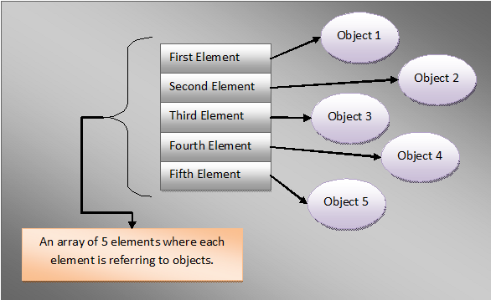
Arrays of objects
Array can hold the references to any type of objects.
It is important to note that array can contain only references to the objects, not the objects itself.
Notes:
*

Slide 54
Arrays as parameters
Arrays can be passed to method as arguments and methods can return an array.
Arrays are Passed-By-Reference. That means, When an array is passed to a method, reference of an array object is passed not the copy of the object.
So, Any changes made to object in the method will be reflected in the actual object.
Notes:
*

Slide 55
Multi-Dimensional Array
A multi-dimensional array is very much similar to a single dimensional array.
It can have multiple rows and multiple columns unlike single dimensional array
datatype[ ][ ] identifier;
int[ ][ ] arr = new int[10][10];
Notes:
*

Slide 56
Jagged array
Jagged arrays in java are arrays containing arrays of different length.
Jagged arrays are also multidimensional arrays. Jagged arrays in java sometimes are also called as ragged arrays.
int[ ][ ] arr = new int[3][ ]; //there will be 10 arrays whose size is variable
arr[0] = new int[3];
arr[1] = new int[4];
arr[2] = new int[5];
Notes:
*

Slide 57
Inheritance (IS-A)
Inheritance is one of the key features of Object Oriented Programming.
Inheritance provided mechanism that allowed a class to inherit property of another class.
When a Class extends another class it inherits all non-private members including fields and methods.
Inheritance in Java can be best understood in terms of Parent and Child relationship, also known as Super class(Parent) and Sub class(child) in Java language.
Notes:
*

Slide 58
LAB2
Write a program to print the names of students by creating a Student class. If no name is passed while creating an object of Student class, then the name should be "Unknown", otherwise the name should be equal to the String value passed while creating object of Student class.
Notes:
*

Slide 59
LAB2
Create a class named 'Rectangle' with two data members- length and breadth and a method to claculate the area which is 'length*breadth'. The class has three constructors which are :
1 - having no parameter - values of both length and breadth are assigned zero.
2 - having two numbers as parameters - the two numbers are assigned as length and breadth respectively.
3 - having one number as parameter - both length and breadth are assigned that number.
Now, create objects of the 'Rectangle' class having none, one and two parameters and print their areas.
Notes:
*

